Slide 1
Purpose and Philosophy of the Spiritual Curriculum

Slide 2
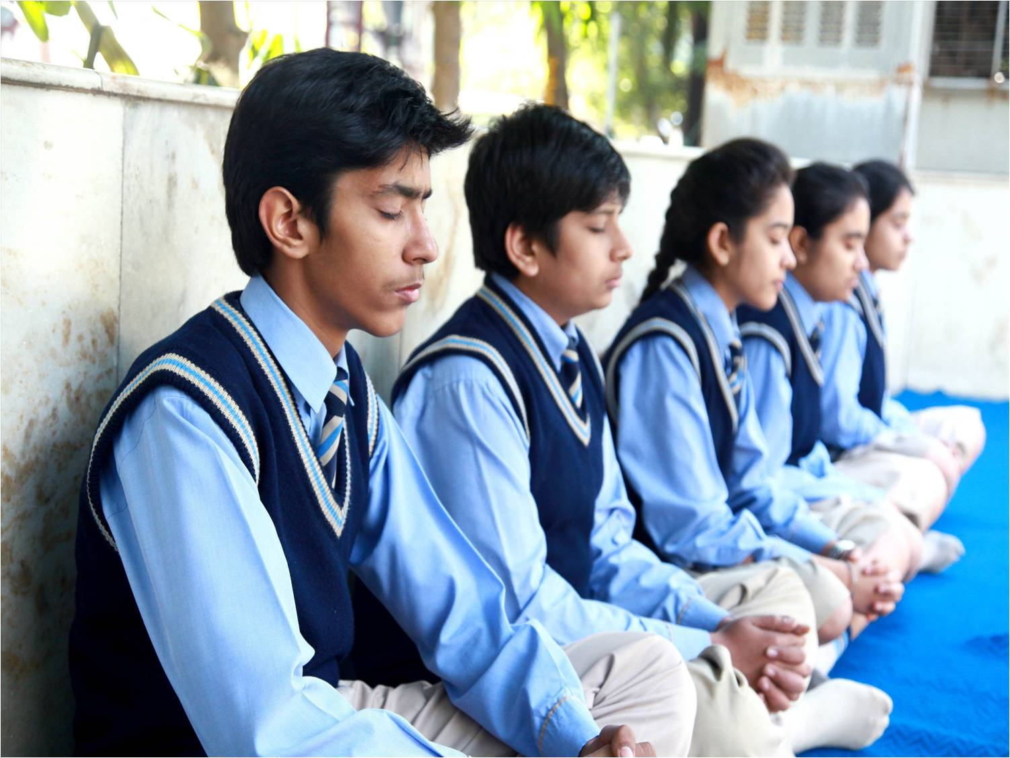
Welcome to the Philosophy and Purose of the Spiritual Curriculum

Slide 3
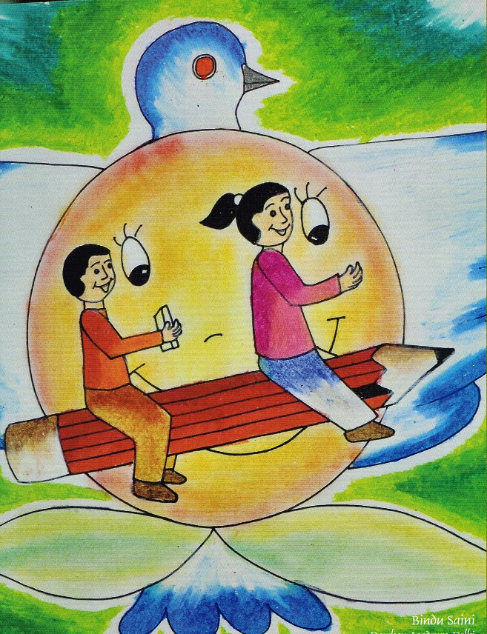
Purpose of the Spiritual Curriculum
The purpose of the spiritual curriculum is to provide a holistic education from Nursery to grade 12 that addresses not only the physical and intellectual development of students, but the spiritual aspect as well.

Slide 4
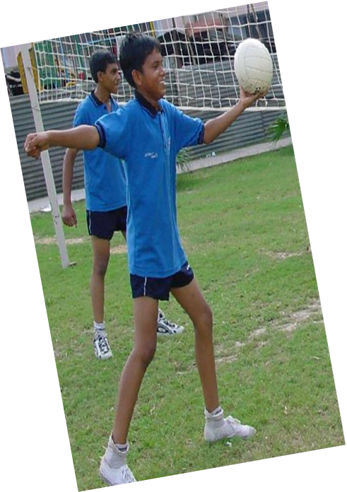
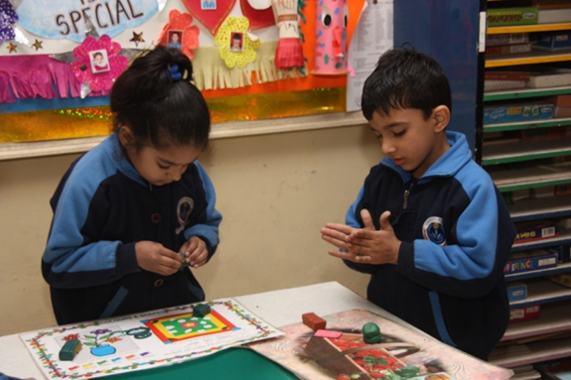
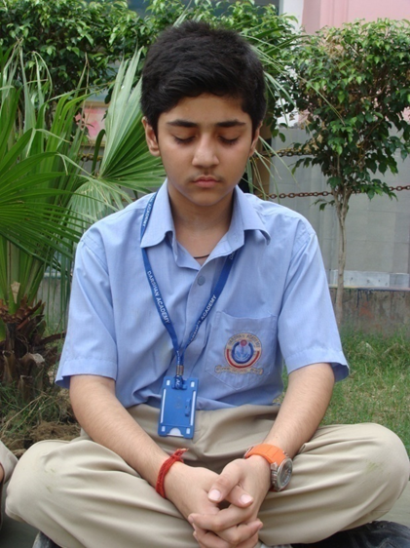
Holistic Education for Body, Mind & Soul

Slide 5
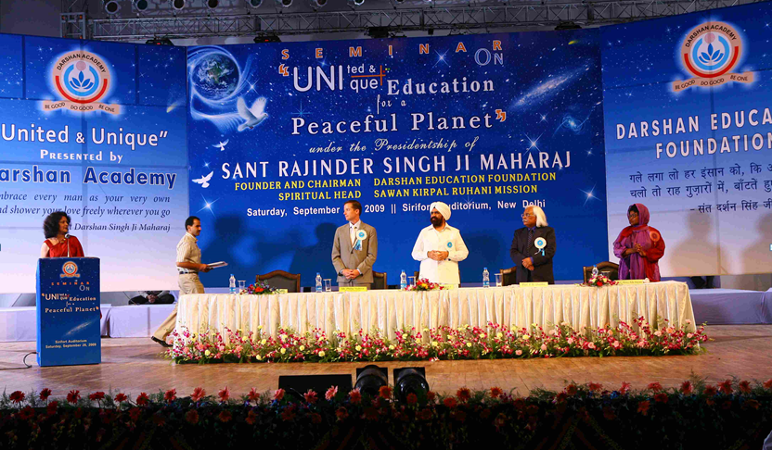
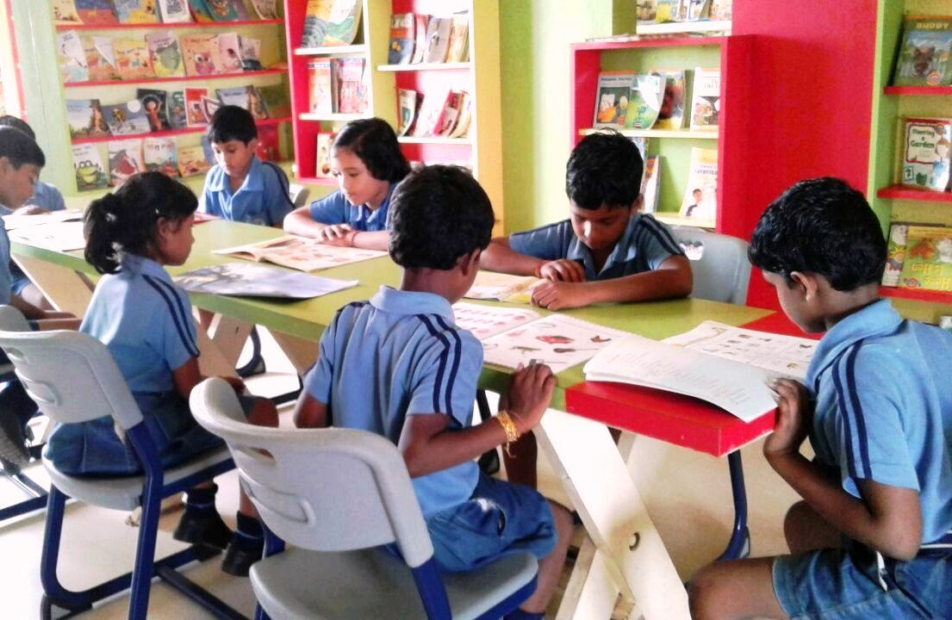
Where is it used?
It was used first in the Darshan Academy schools.

Slide 6
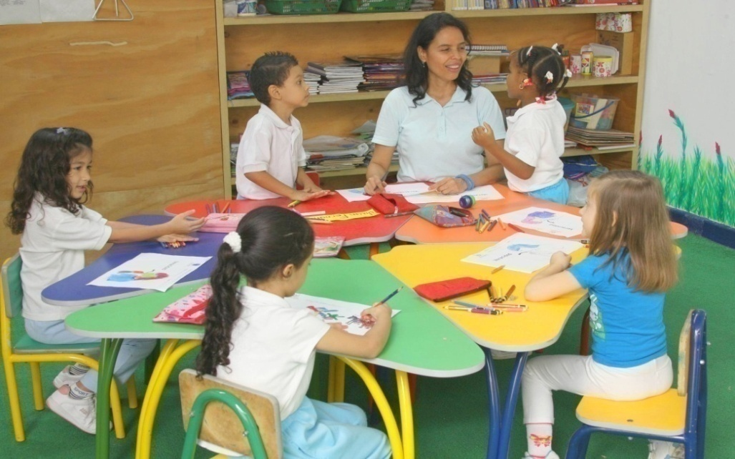
curriclum is open to all
The spiritual curriculum is open to people of all nationalities and faiths and backgrounds.

Slide 7
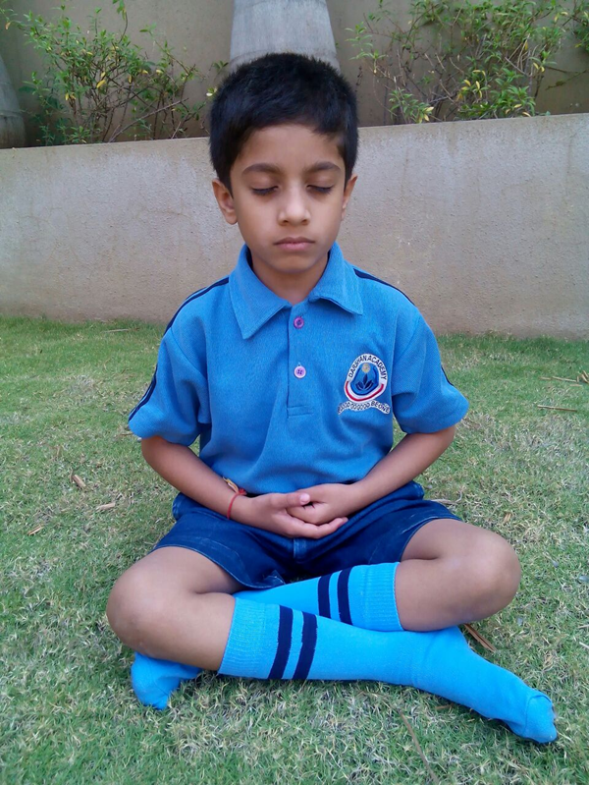
Focus of the
Spiritual Curriculum

Slide 8
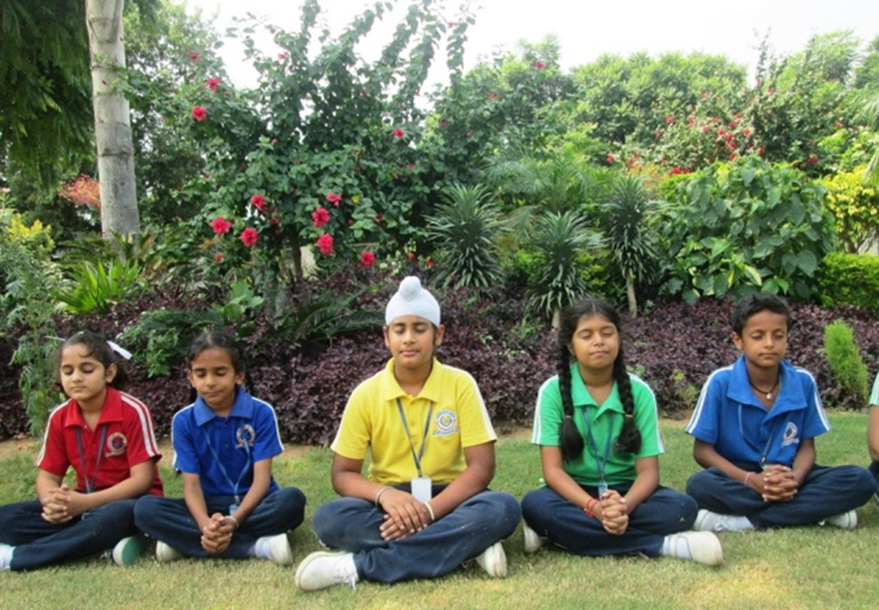
Focus Meditation to know one’s own self and know God

Slide 9
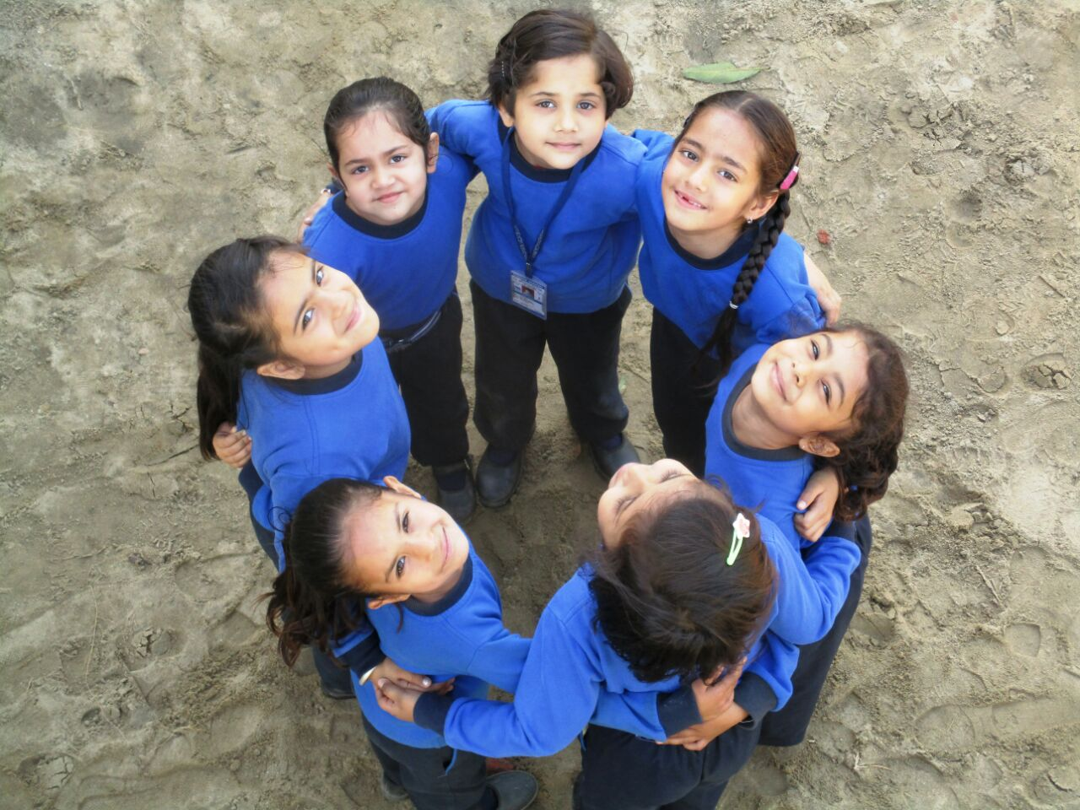
Focus Developing ethical values, and becoming a better person

Slide 10
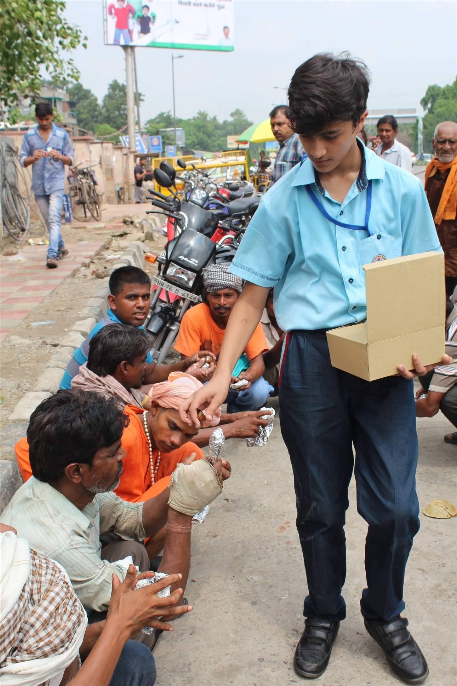
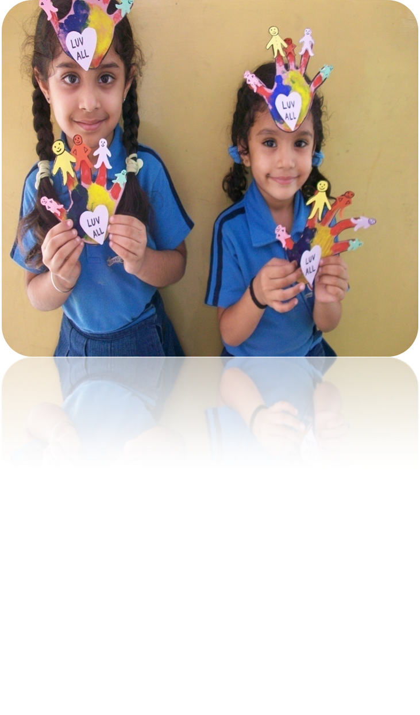
Focus etting

Slide 11
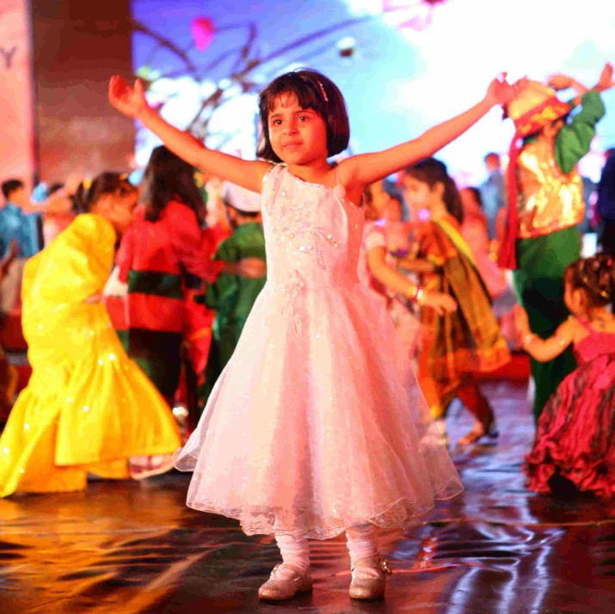
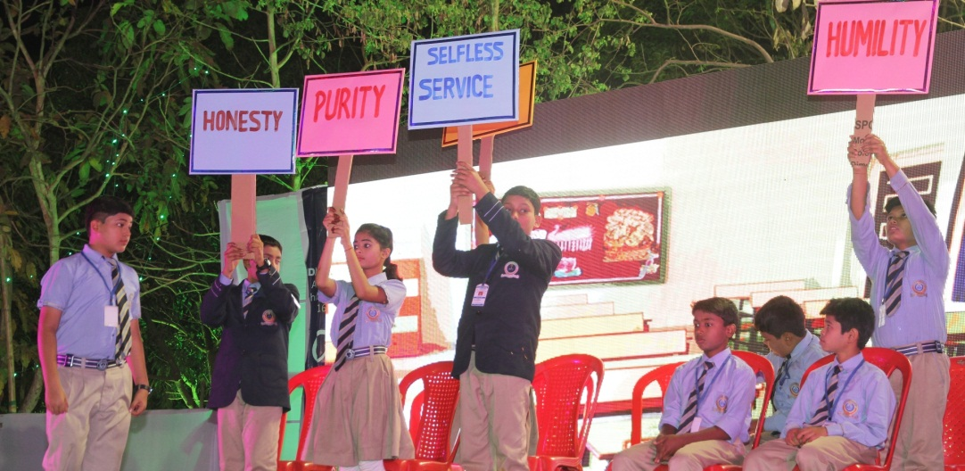
Ethical living includes developing:
nonviolence,
truthfulness,
purity,
humility,
love for all,
selfless service

Slide 12
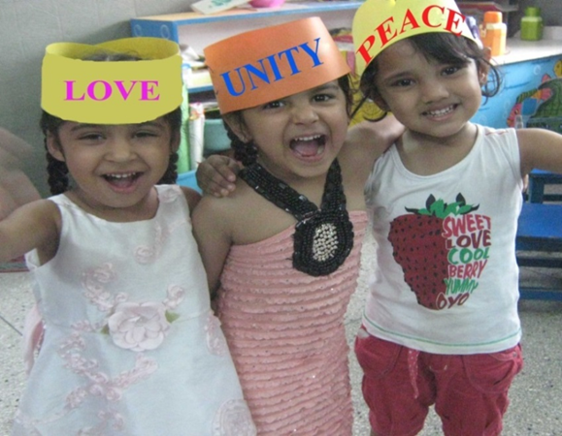
Focus Getting along with others

Slide 13
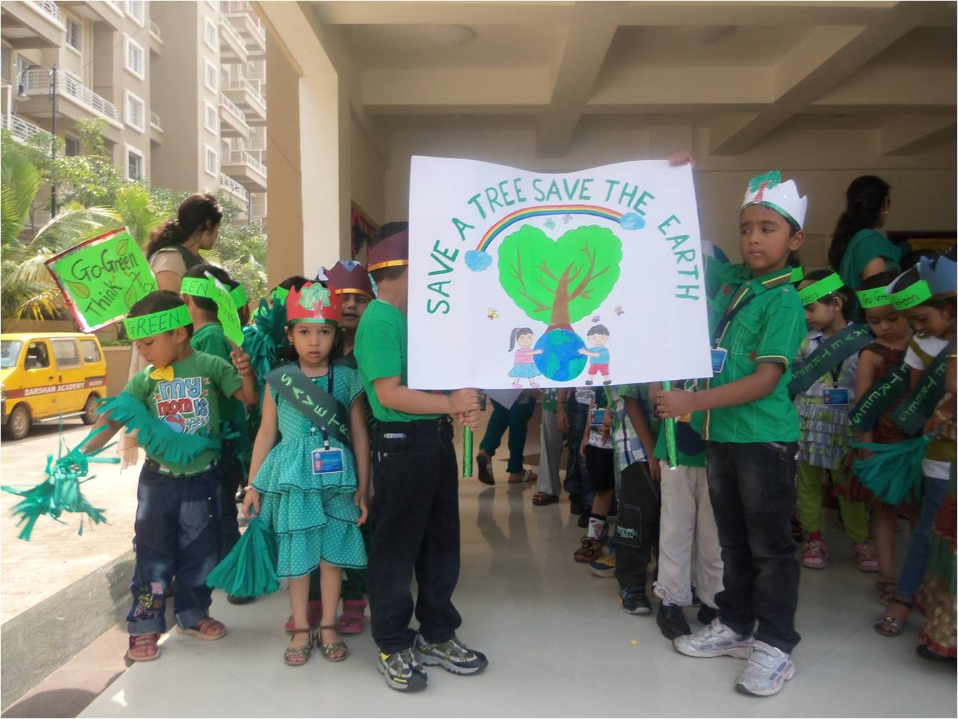
Focus Developing respect for other people, animals, plants, and all creation

Slide 14
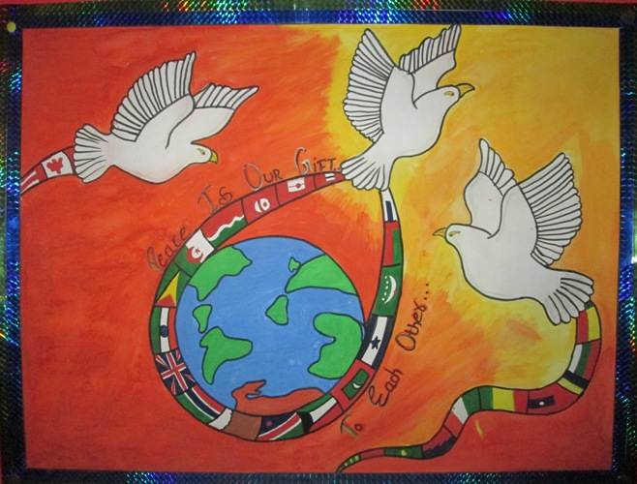
Focus How to make a positive contribution to the world

Slide 15
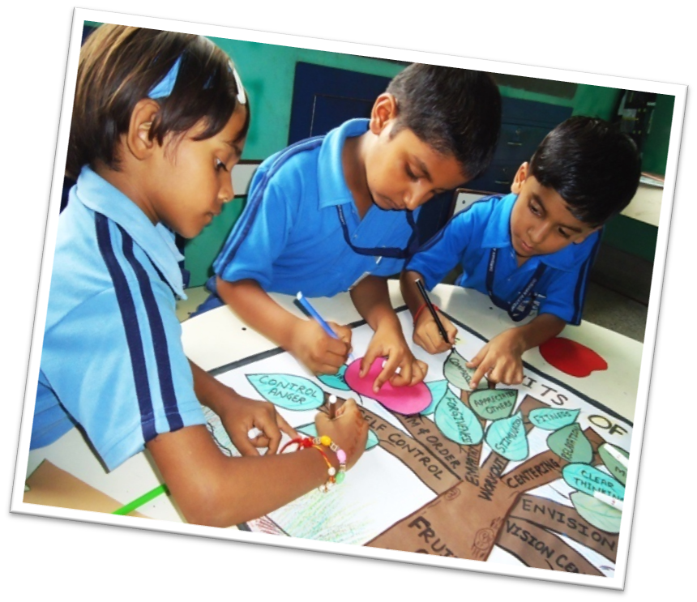

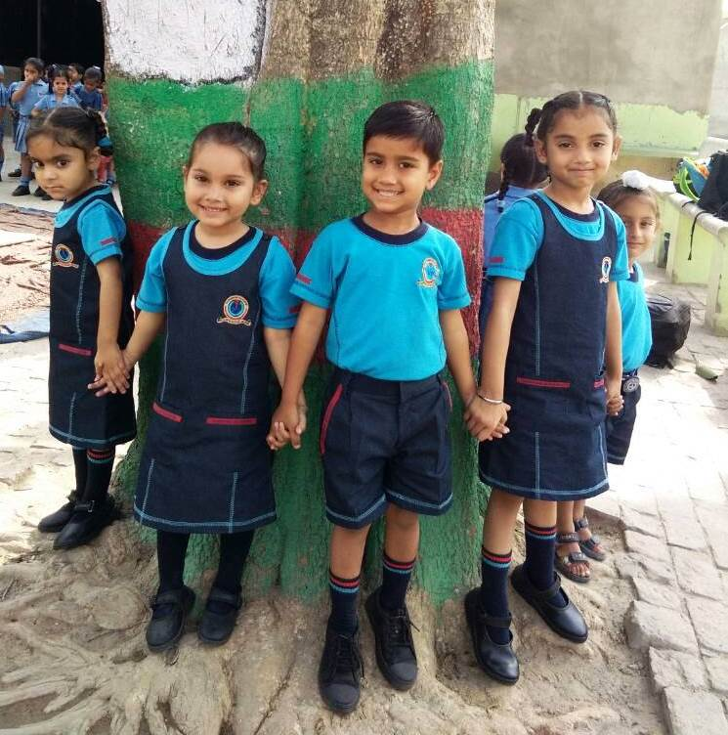
The Spiritual Curriculum
is a blend of
theory and practice

Slide 16
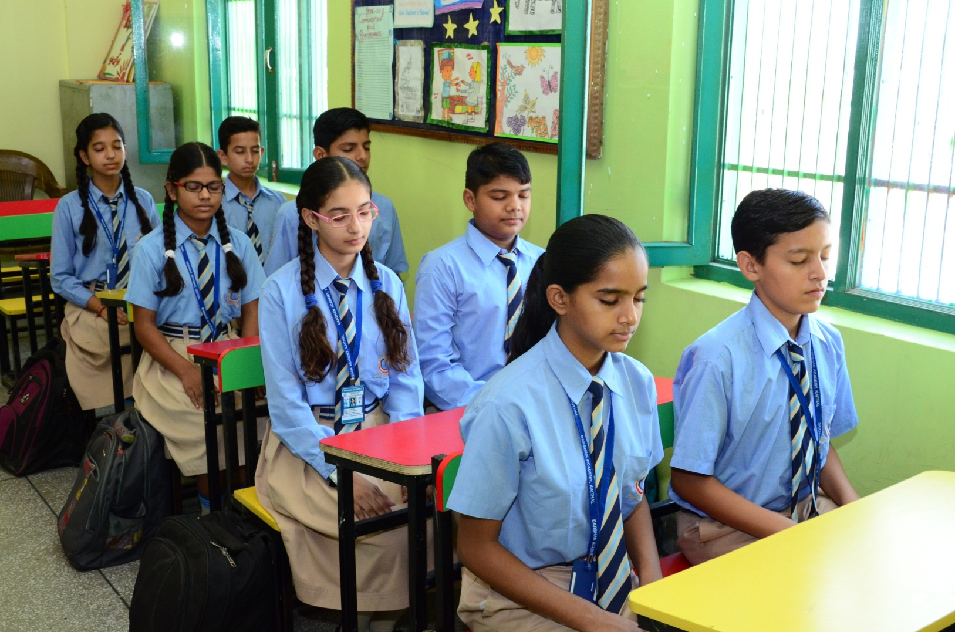
THE PRACTICAL SIDE IS TEACHING STUDENTS
HOW TO MEDITATE

Slide 17
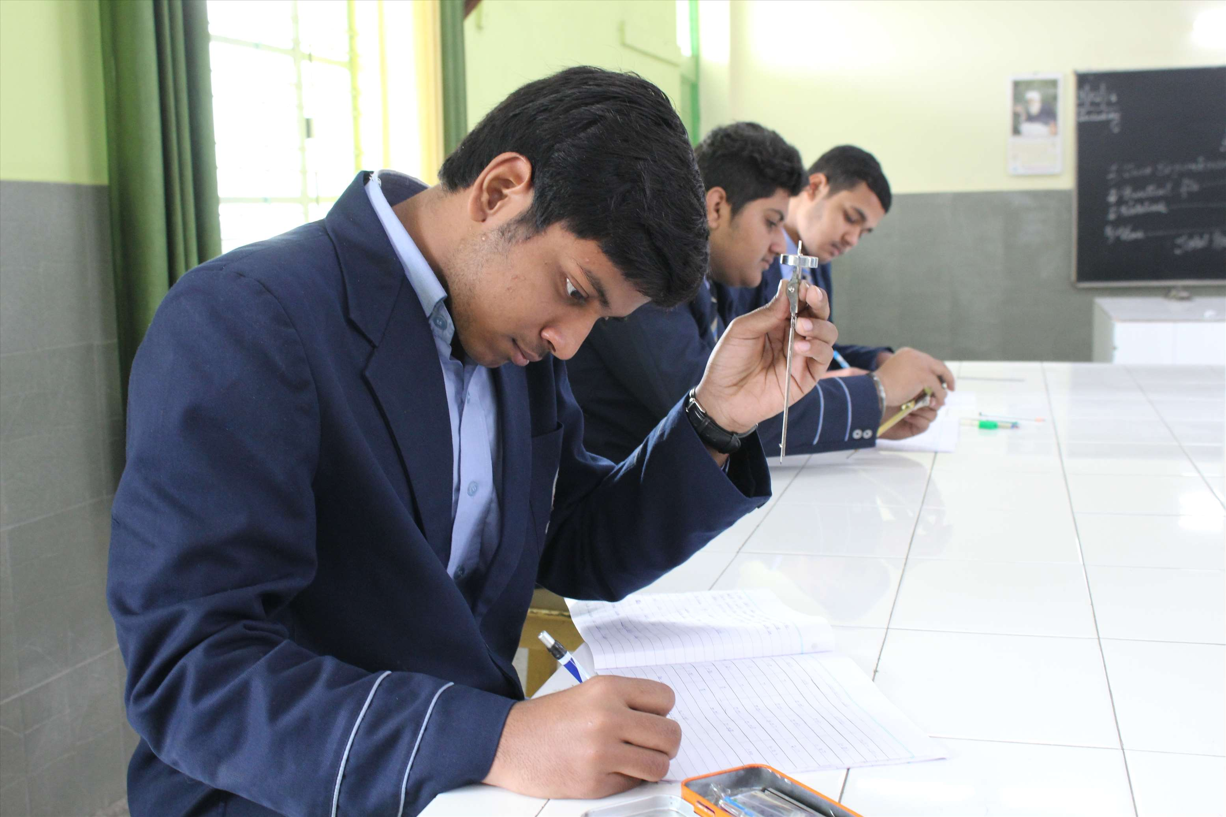
MEDITATION AIDS:
CONCENTRATION

Slide 18
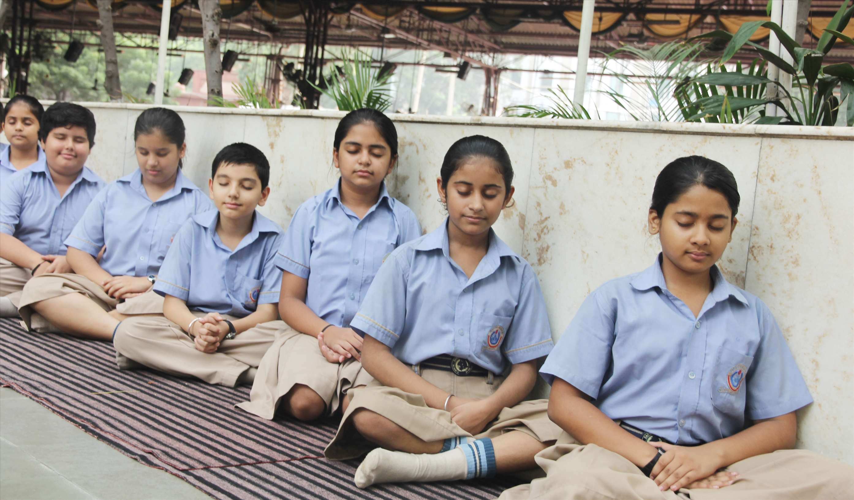
Meditation Reduces Stress

Slide 19
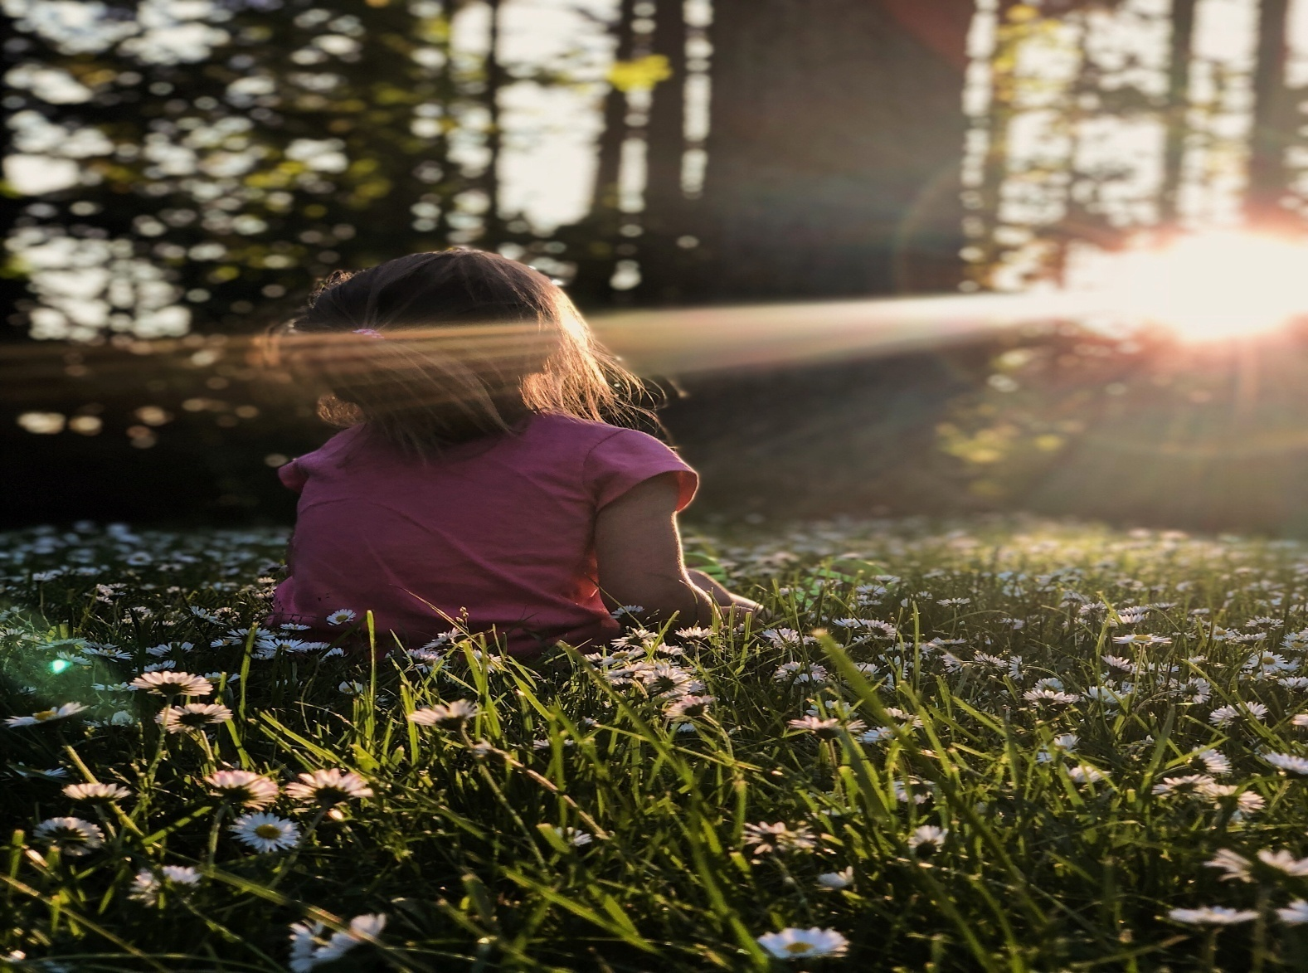
Meditate to Know one’s inner self & find inner peace

Slide 20
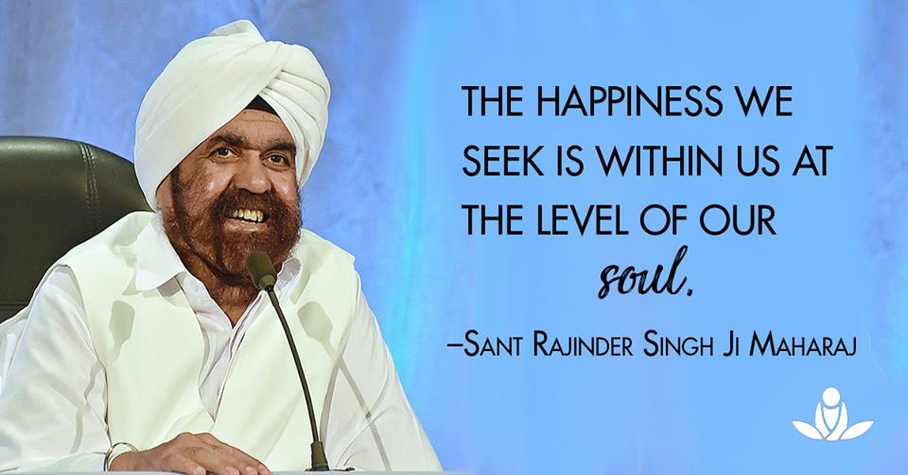

Slide 21

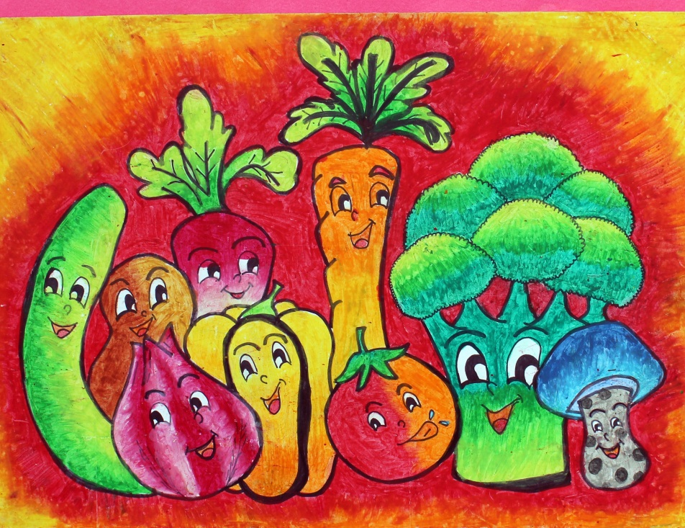
Students learn health & Nutrition & benefits of Vegetarian Lifestyle

Slide 22
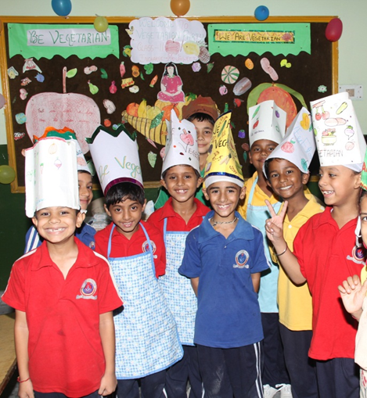
Vegetarian Cooking

Slide 23
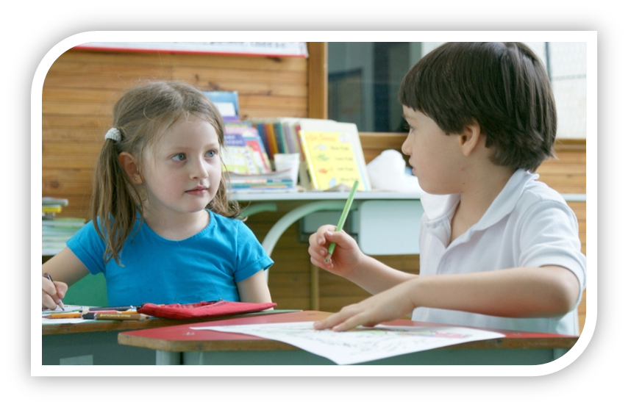
The theoretical side includes
knowledge
and understanding
of the spiritual teachings

Slide 24
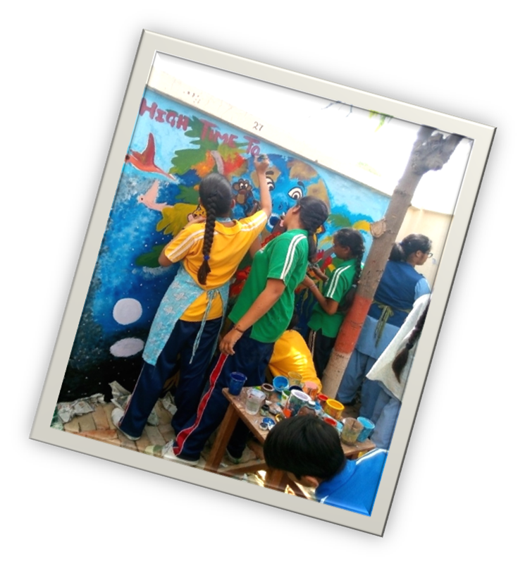
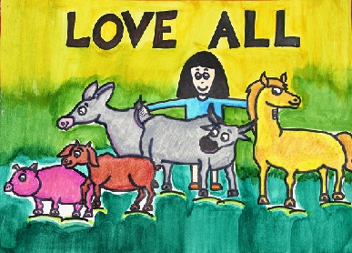
Spirituality and the arts
Involves appreciating role of spirituallity in the fields of Arts

Slide 25
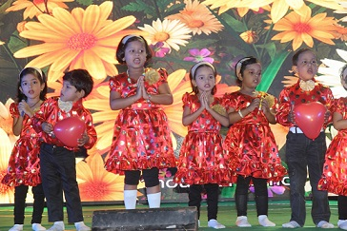
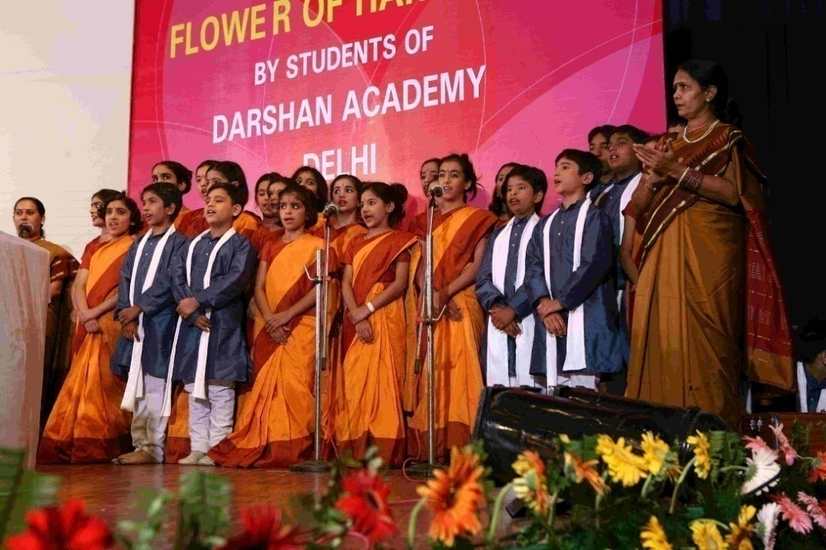
Spirituality & the Arts Music

Slide 26
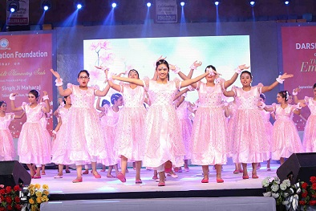
Spirituality & the Arts Dance

Slide 27
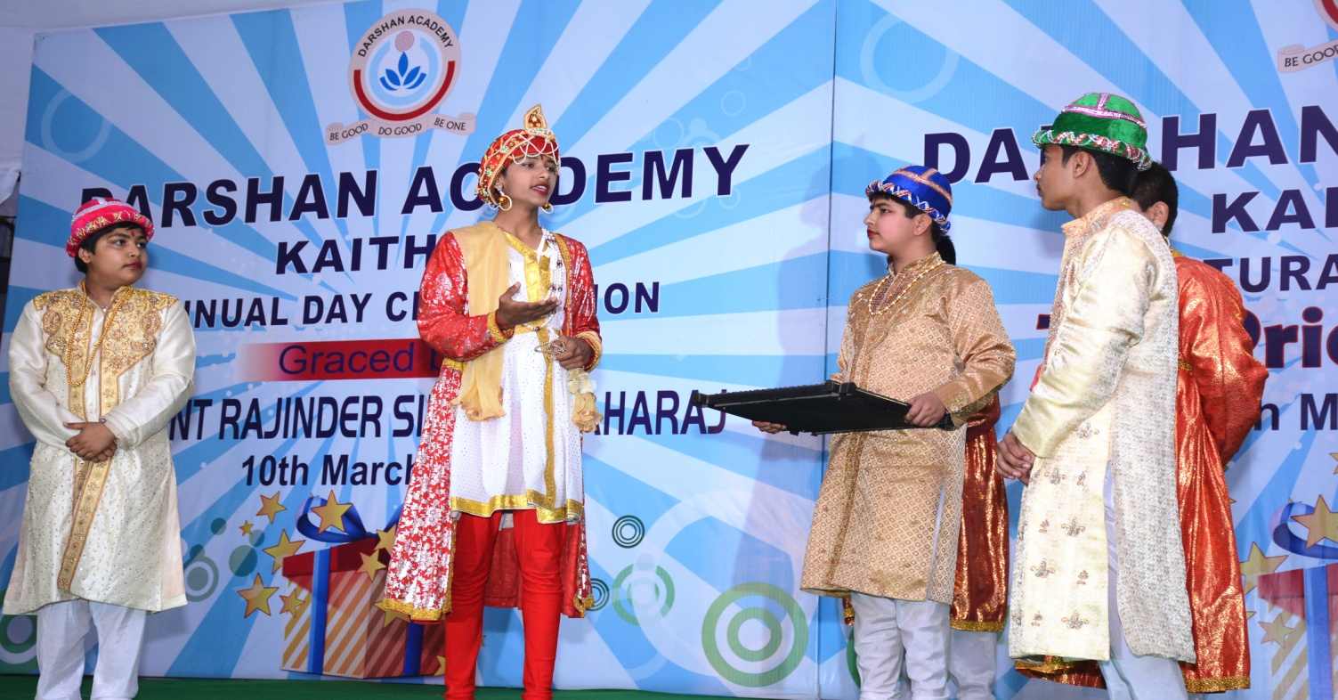
Spirituality & the Arts Drama

Slide 28
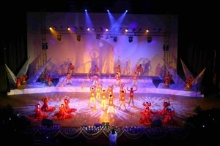
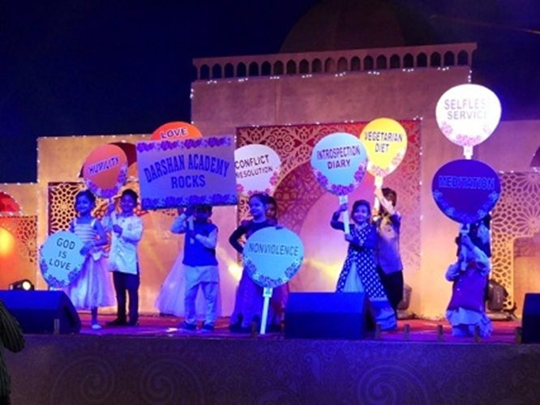
Poetry, literature, audio-visual media, and allow for student exploration and expression of their own spirituality in these Art fields.

Slide 29
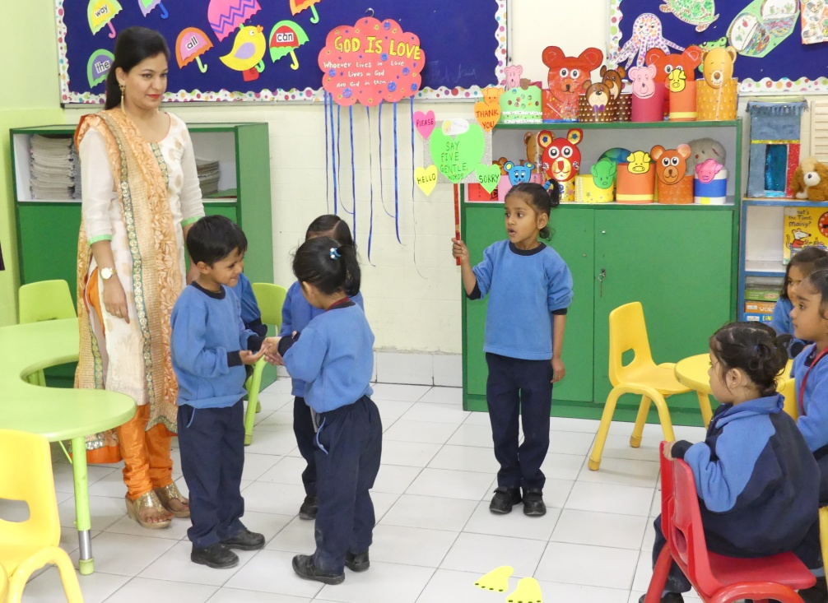
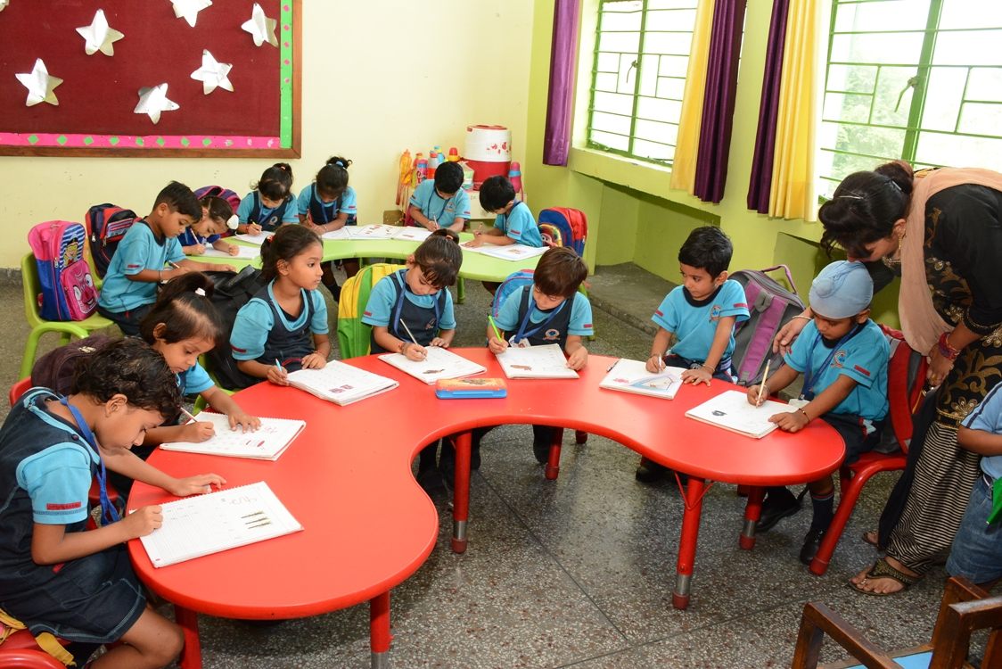
Positive Classroom Behaviour

Slide 30
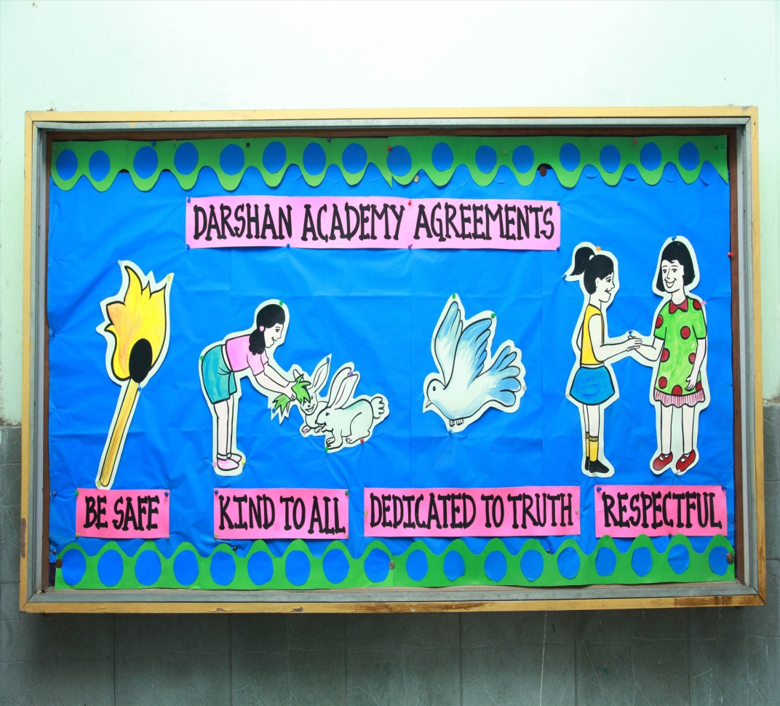
Students are taught positive behaviors and to have respect for others

Slide 31
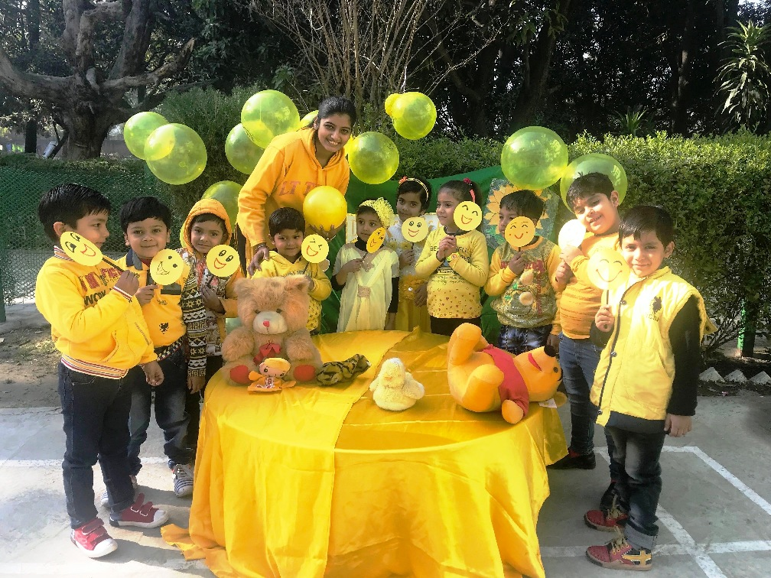
Students become Fully integrated human beings: Mentally, physically, emotionally & Spiritually

Slide 32
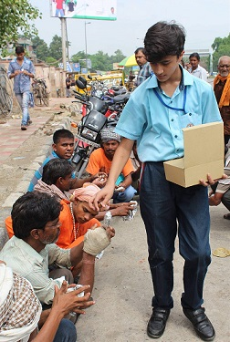
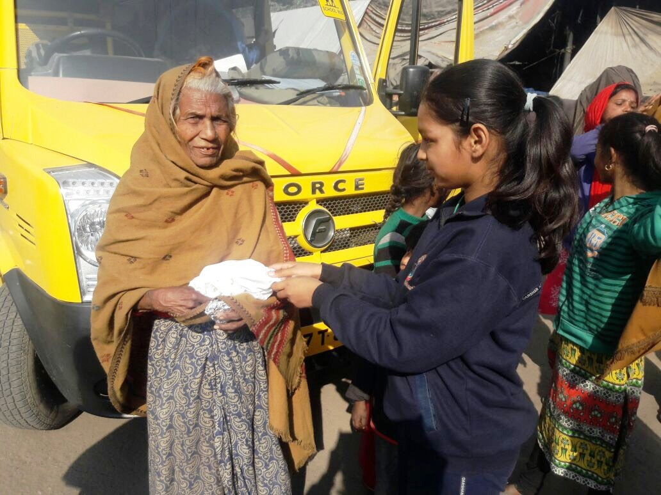
Students learn to Make the world a better place
ROTI BANK

Slide 33
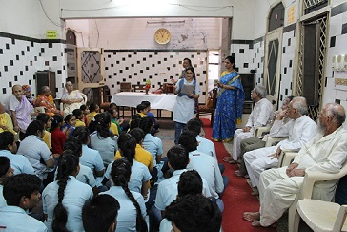
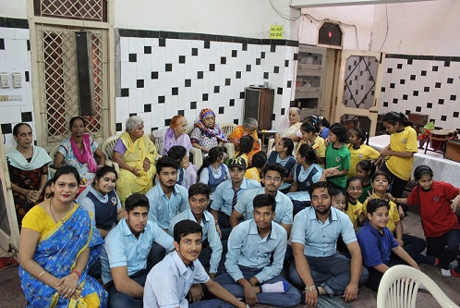
Visit to Old age home

Slide 34
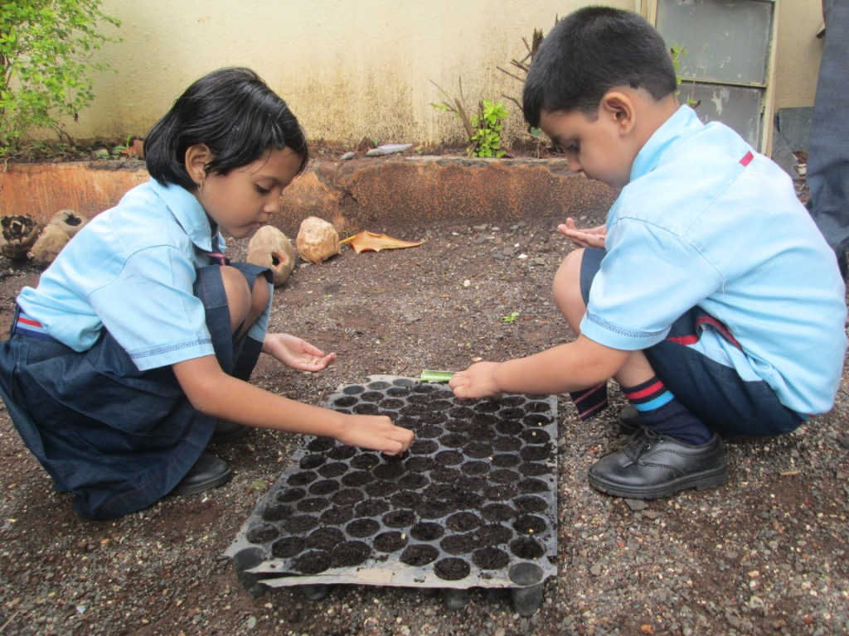
Take care of the Environment

Slide 35
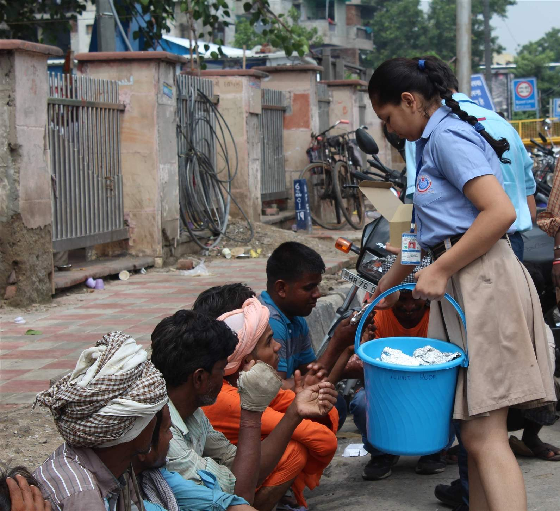
They learn the value of helping others to make the world a better place.

Slide 36
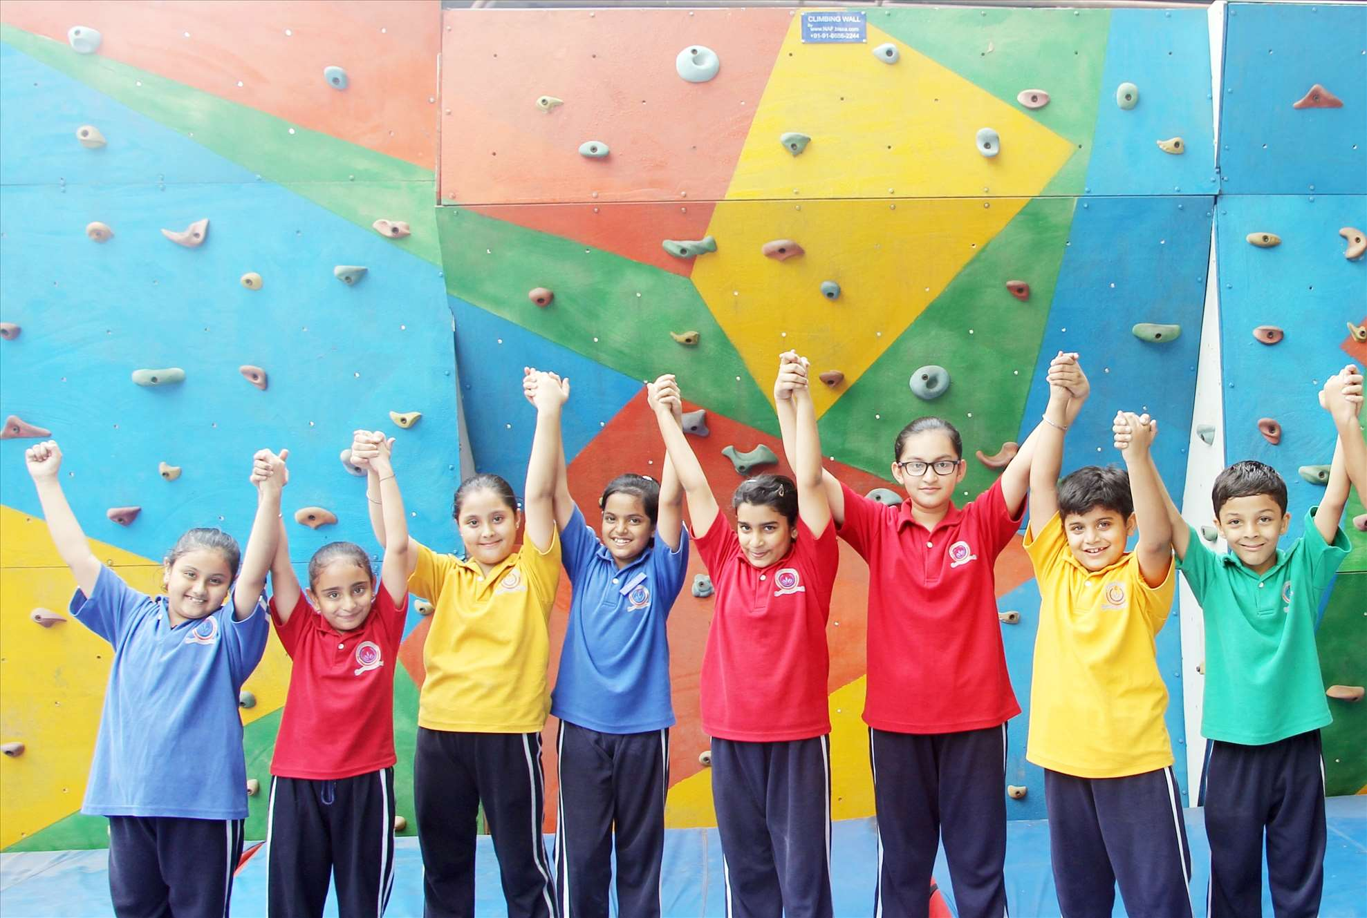
Curriculum for body, mind and soul

Slide 37
Spiritual Curriculum Spiral Principle
Example: Topic Truthfulness
Grade 1 Telling the Truth
Grade 2 Not Stealing
Grade 3 Gossip
Grade 4 Trust
Grade 5 Being true to Yourself and God
Grade 6 Hypocrisy
Grade 7 Honesty in the Workplace
Grade 8 Searching for Spiritual Truth

Slide 38
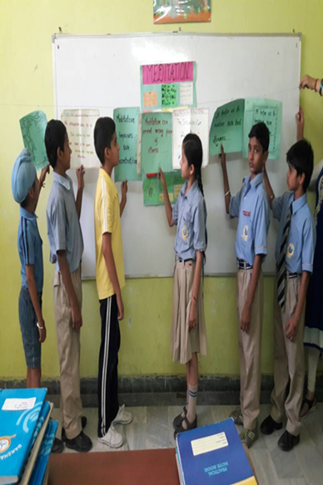
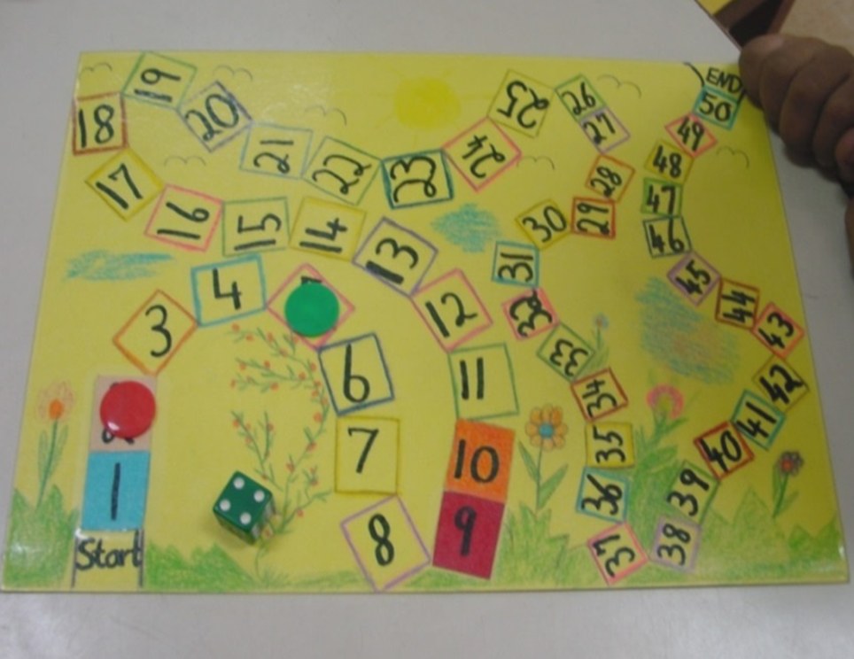
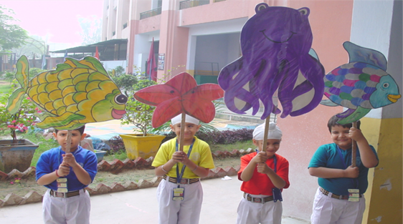

Learning is Fun through Use of Interactive Teaching Techniques

Slide 39

Creates a Caring, positive Classroom Environment

Slide 40

Spiritual Curriculum Is Creating Peacemakers

